Slide 1
Heating and Cooling Curves

Slide 2
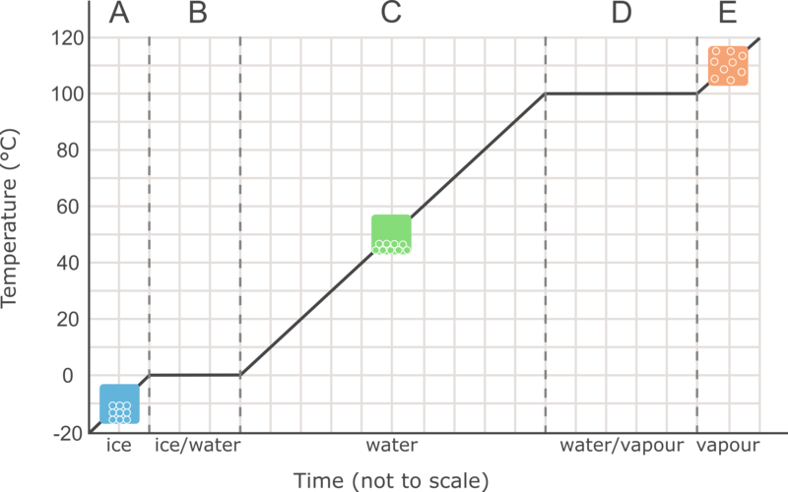
By the end of this lesson, you should be able to:
Understand and interpret a heating curve.
Explain how adding or removing energy affects the temperature of a substance.
Explain why a substance's temperature does not change during state transitions.

Slide 3
Heating and cooling curves can be used to show how the temperature of a substance changes over time when it is heated or cooled.
Let’s look at the heating curve for water. If some ice is removed from the freezer and then heated at a constant rate while the temperature is recorded, the following curve is produced.
The vertical (y) axis shows the temperature of the water, while the horizontal (x) axis shows the time.

Slide 4
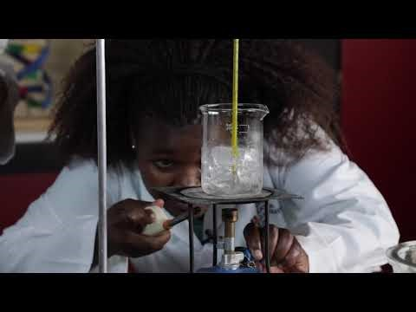

Slide 5
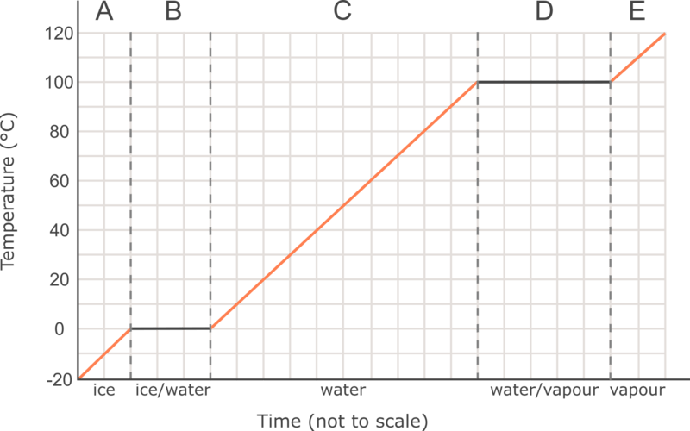
The upward sloped parts of the graph show where the temperature of the water is increasing as the water is heated.
Section A shows the temperature of the solid water (ice) increasing, section C shows the temperature of the liquid water increasing, and section E shows the temperature of the water vapour increasing.
We can see that the overall temperature of the water increases from −20∘C to 120∘C.

Slide 6
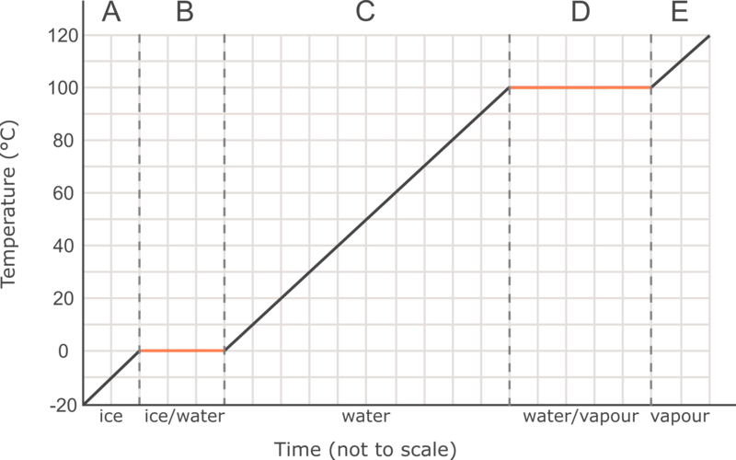
But what is happening at the flat parts of the graph?
During sections B and D the temperature does not increase, even though the water is being heated constantly.
These sections show us where the state changes are occurring. In section B, solid water (ice) is melting into liquid water. In section D, liquid water is boiling to become water vapour.

Slide 7
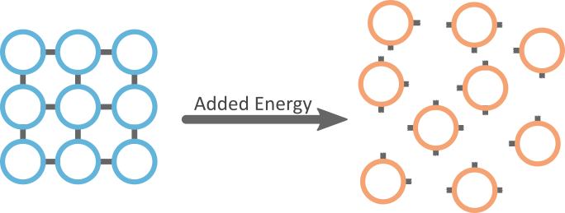
To understand why the graph is flat at these sections, we need to remember what is occurring during these state changes.
During melting and boiling, the bonds between the particles of the water are being broken.
The particles in the water are strongly attracted to each other so breaking bonds between particles requires energy. This energy comes from the heat that is being constantly applied.

Slide 8
During state changes, all the heat energy is being used to break the bonds between particles instead of increasing the temperature of the water. This is why these sections of the heating curve are flat.

Slide 9
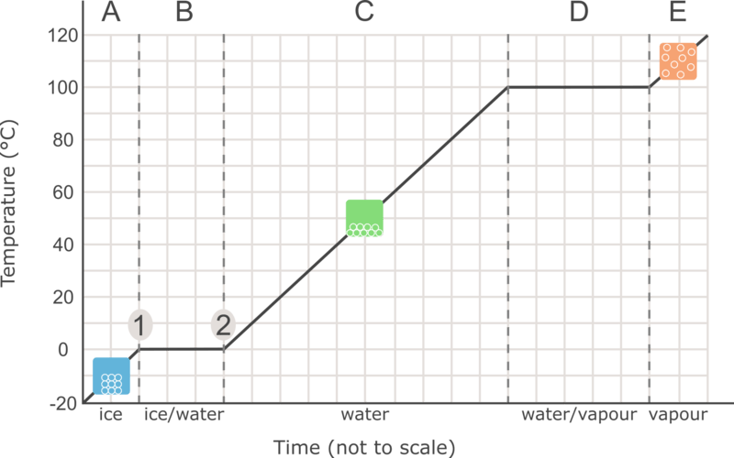
Using what we know about heating curves, we can understand what is happening at different parts of the curve.
In section A, the ice is being heated until it reaches the melting point at 0∘C. At point 1 the melting point is reached and the ice will begin to melt.
During section B, the temperature is constant because melting is occurring. During this section both solid water and liquid water are present. Melting ends at point 2 when all the water is liquid.

Slide 10
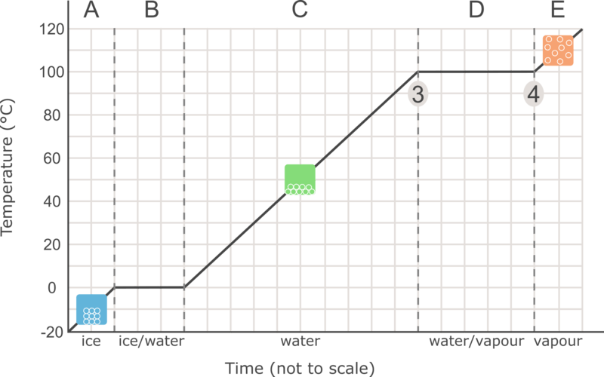
In section C, all the water is liquid and the temperature is increasing from the melting point (0∘C) to the boiling point (100∘C).
When the boiling point is reached at point 3, the water begins to boil from a liquid to a gas. The curve is flat again because boiling is occurring. During boiling, both liquid water and gaseous water are present.
Once all the water is gaseous at point 4 the temperature of the water vapour will begin to increase (section E).

Slide 11
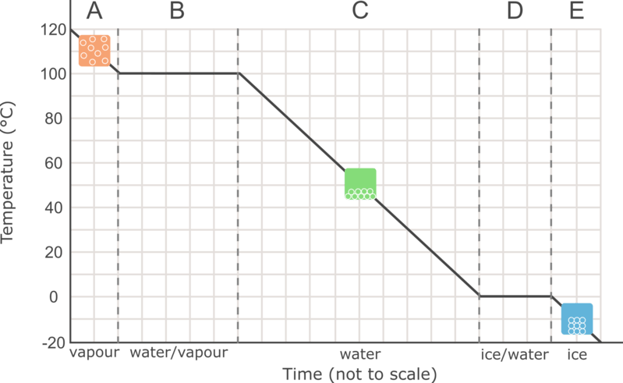
Now let's look at the cooling curve for water.
If some water vapour is cooled while the temperature is recorded, the following curve is produced.

Slide 12
Just like the heating curve, the sloped parts of the graph show where the temperature is changing, and the flat parts of the graph show the state changes.
The key difference is that the water is being cooled, so the graph shows the temperature decreasing from 120∘C to −20∘C. A decrease in temperature tells us that heat energy has been released from the water into the environment.

Slide 13
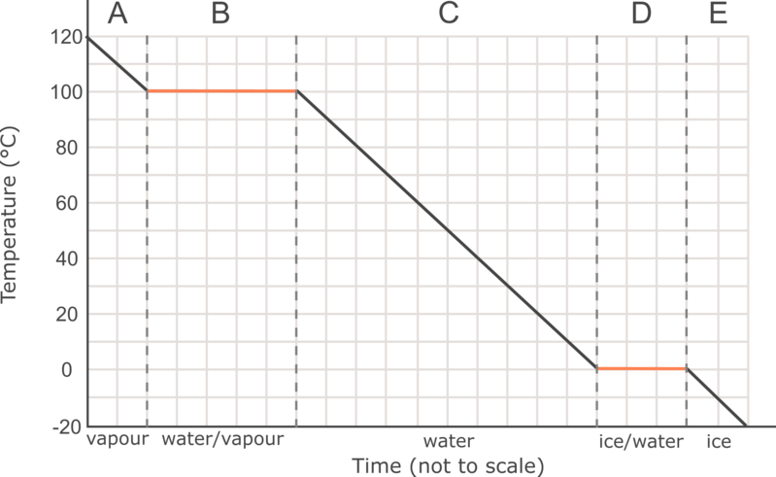
Let’s take a closer look at the flat sections of the cooling graph.
During section B, the water vapour is condensing to liquid water. This occurs at the same temperature as the boiling point (100∘C).
During section D, the liquid water is freezing to become solid water (ice). Freezing occurs at the same temperature as the melting point (0∘C).

Slide 14

During condensation and freezing, bonds are being formed between the particles.
The process of forming bonds releases energy into the environment.
This means that during a state change, the energy being removed during the cooling process is coming from the formation of bonds and not from the decrease in temperature.

Slide 15
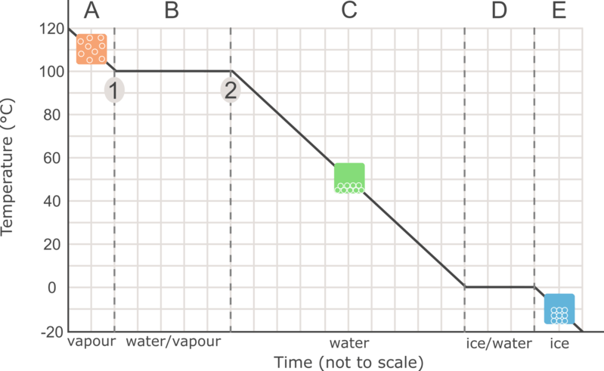
Using what we know about cooling curves, we can understand what is happening at different parts of the curve.
In section A, the water vapour is being cooled until it reaches 100∘C. Condensation begins at point 1 when the gaseous water begins to condense into liquid water.
In section B, the temperature is constant because condensation is occurring. During this section both gaseous water and liquid water are present. Condensation ends at point 4 when all the water is liquid.

Slide 16
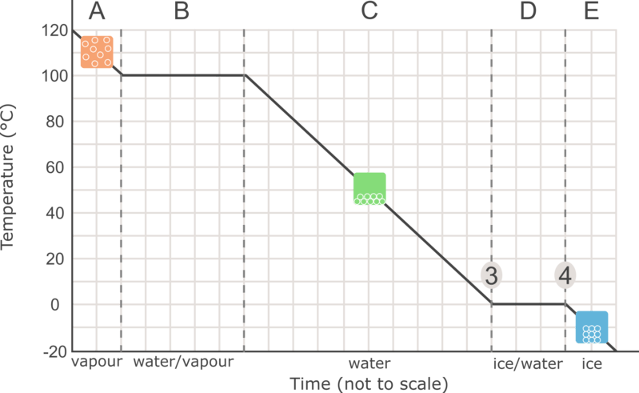
In section C, all the water is liquid and the temperature is decreasing from 100∘C to 0∘C.
When the freezing point is reached at point 3, the curve is flat again because the liquid water is freezing into solid ice. During freezing, both liquid water and solid water are present (section D).
Once all the liquid water becomes ice at point 4, the temperature of the ice will continue to decrease (section E).

